Slide 1
Category review: Chips
June 2020
Retail Analytics
Brand note: If client logo is not required, use alternate title page layout right click slide thumbnail > Layout > Title

Slide 2
Notes:
To view Privacy video explaining how important data privacy is to Quantium, please click here: https://www.youtube.com/watch?v=Zq1QDAkoRzU
or here Q:\Company Reference\Brand & Design\Brand videos\Q Privacy.mp4
At Quantium, we believe that data is the behavioural footprint of humanity and that it has to be treated with the utmost care and responsibility.
Histories, attitudes, indeed lives are stored within it in ways that aren’t always apparent – and that’s what makes its potential so powerful.
To work with it responsibly, sensitively, we set ourselves the highest data privacy protection and governance standards.
We have spent 17 years perfecting privacy-by-design and secure-by-design principles. Central to this is not holding any personally identifiable information about people –
we neither receive it, and put the necessary protections in place to be unable to decipher it.
Every aspect of handling data is safeguarded: from its de-identification, to its encryption – data security is paramount and of the highest grade.
We pride ourselves on gaining the trust of iconic organisations around the world through years of securely working with their data,
and in turn the trust that builds with their stakeholders.

Slide 3
Executive summary
01
Customer Analysis
Sales are highest near Christmas.
Average weight/size chips packets are in demand, particularly 175g and 150g.
Most people likes to buy 2 packets of chips at a time.
Old and Young Single/Couples more likely to buy Chips.
People under premium category likely to buy less Chips than any other category.
02
Analyse Trial Stores
Changes made for Store 77 and 88 show’s significant results, but Store 86 does not show significant results.

Slide 4
01
Customer Analysis

Slide 5
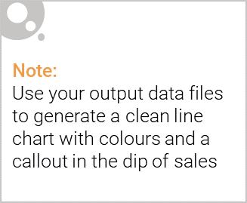
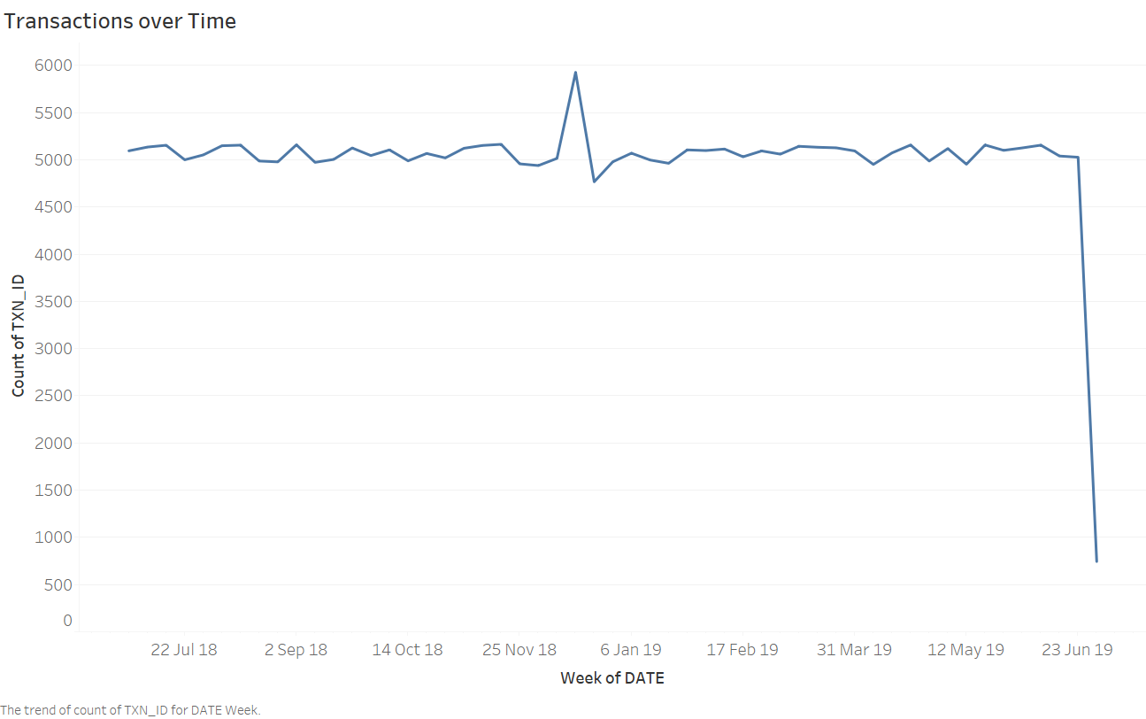
Period with most sales throughout the year.

Slide 6
Insights: The sales are same throughout the year on average, but there is a spike up in December before 25 December 2018 and we know that on December 25 it is Christmas day.
Result: Sales rocketed near Christmas.
Recommendation: As we see that sales go higher near Christmas, that means the sales goes high near biggest occasion, so we can make some strategy to increase sales near other big occasions also like New Year or Halloween etc.

Slide 7
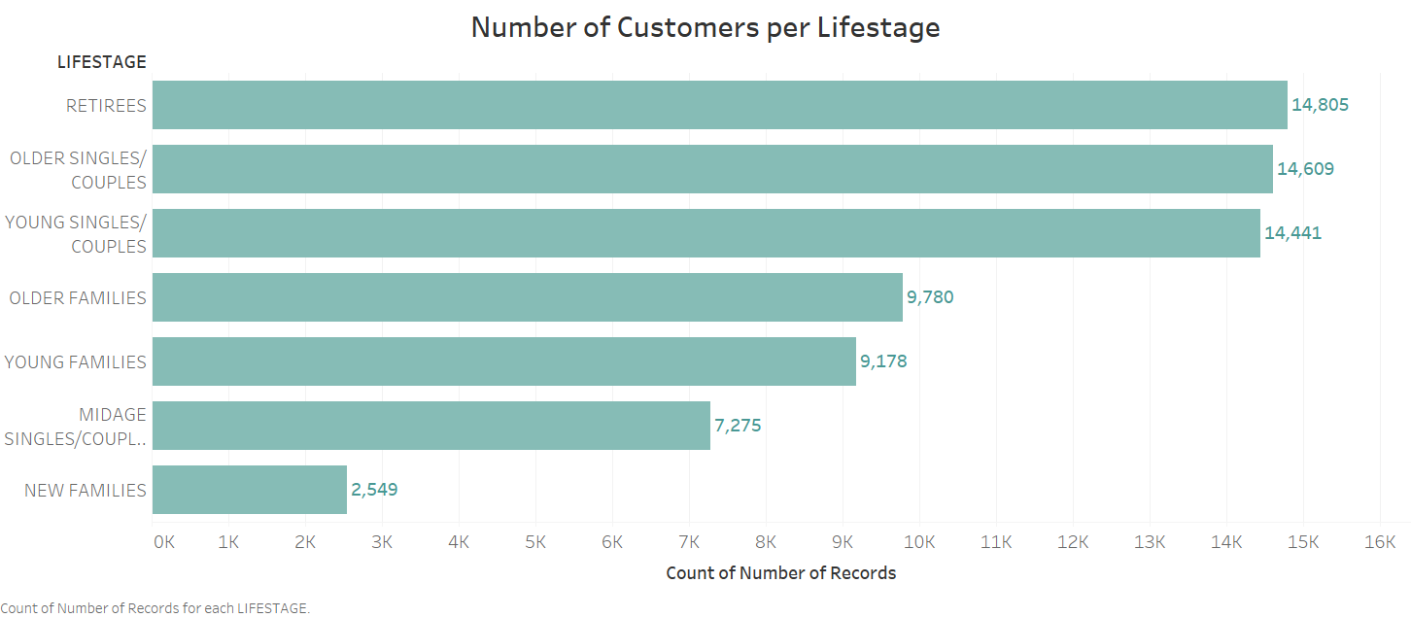
Chips popularity with respect to Life stage.

Slide 8
Insights: Chips are most popular among Retirees and Older and Young single couples. We see that Young and Older families less likely to buy chips. Basically the customers without families more likely to buy chips than the person with families. But we also see that there is a huge Drop in the customer with the new families.
Result: Chips are more popular in people without families than the people with families.
Recommendation: The people that have new families less likely to buy chips, so we need to find what the new families mostly buy, and then once we find out the product that new families buys the most, we will place the chips near that product.

Slide 9
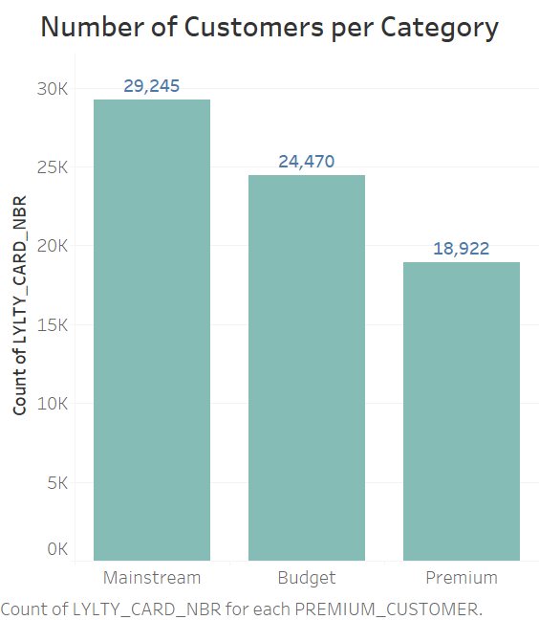
Popularity of Chips with respect to Category

Slide 10
Insights: People with category mainstream more likely to buy chips followed by the budget category But premium customers less likely to buy chips than mainstream and budget category maybe because they are more health conscious.
Result: Premium customers less likely to buy chips.
Recommendation: Try to sell baked chips to the premium customers instead of fried chips as baked chips are more healthy.

Slide 11
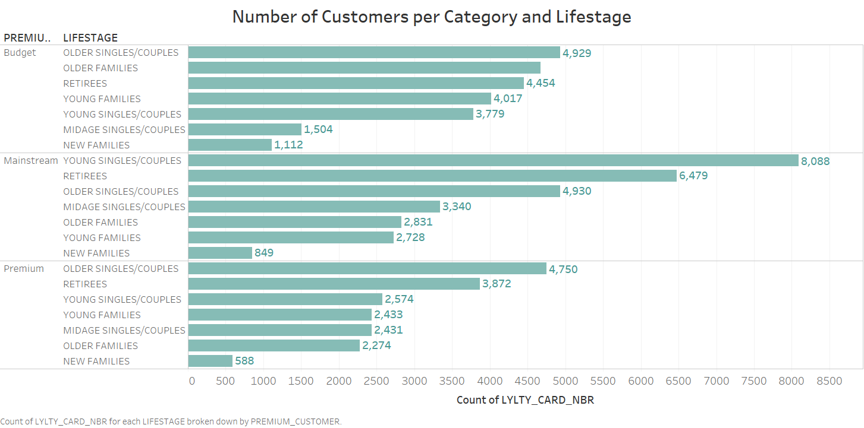
Effect of Life stage by Category on Chips demand.

Slide 12
Result: In Budget category everyone love to buy chips except mainstream single/couples, In Mainstream Single/Couples and retirees more likely to buy chips and in Premium category Older Single/Couples and retirees more likely to buy Chips and New families have consistently low count in each category.
Recommendation:
1. Focus on Families in Mainstream category.
2. Focus on young/mid age single and couples and Families in Premium category.
3. Focus on Mid age Single/Couples in Budget category.

Slide 13
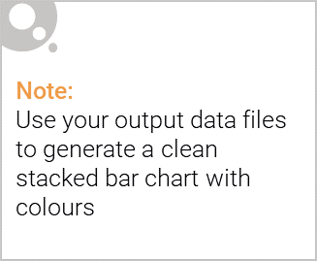
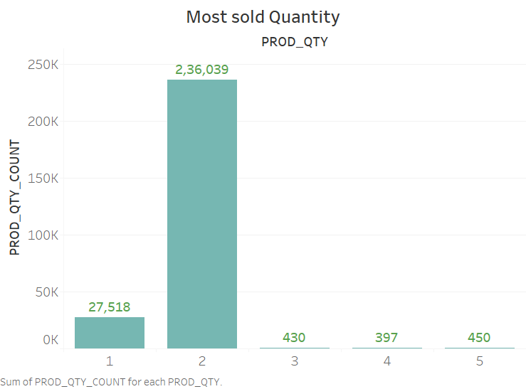
Editable (delete this)
Most sold quantity of Chips.

Slide 14
Insights: Customer most likely to buy 2 packet of chips followed by 1 packet of chips, and very less likely to buy 4 to 5 packets of chips at a time.
Result: Customers more likely to buy 2 packets of chips at a time.
Recommendation: As you see that there is huge difference between transaction count of 2 packets and transaction count of 3 packets. So we can give discount on 3 packets of chips in order to convert customer buying 2 packets to 3 packets. If this happens then there will be huge increase in sales of chips.

Slide 15
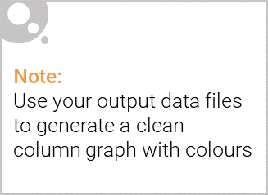
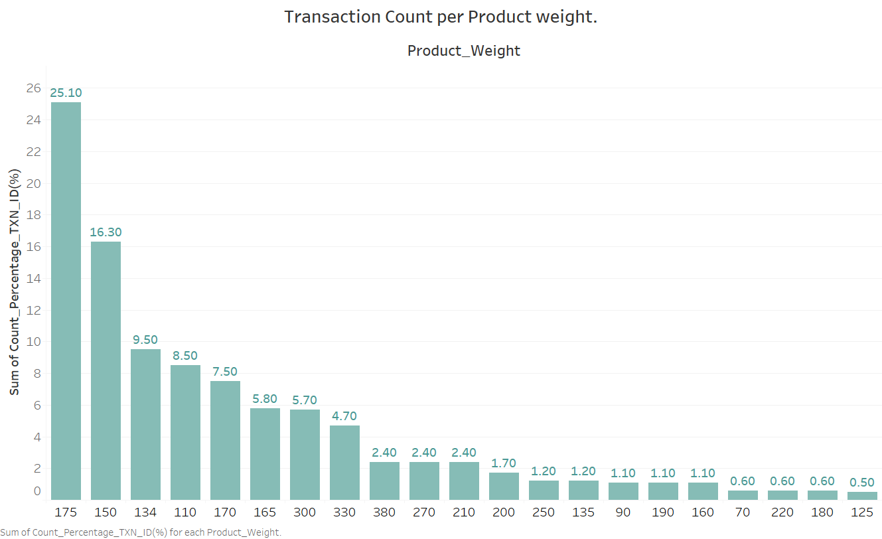
Effect of weight(g)/size on demand.

Slide 16
Insights: We see that the packages that are not to large nor too small are sold the most. Here we see that 25% of the people buys the packet of weight 175g followed by 150g with percentage 16.3% and packet of weight 134g with percentage 9.5%.
Result: We see that the packets with the average sizes are most sold, particularly (175g and 150g).
Recommendations: Place some of the average size chips packets near the billing counter particularly of weights (175g, 150g, 134g, 110g), so that every time people go for billing they notice the packets of Chips and the chips lovers mostly buy a packet even when they do not come in the grocery store to buy chips, as chips are of small size that leads to less money. This will increase more sales of average size chips.

Slide 17
02
Trial Stores Performance

Slide 18
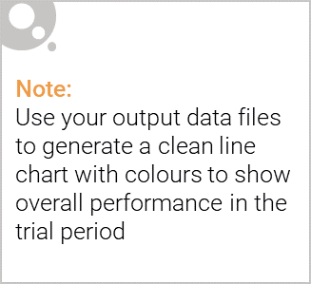
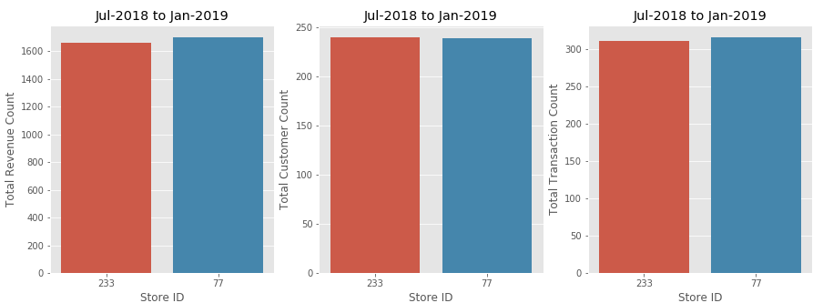
We've found control store 233 for trial store 77.
You can see from the bar graphs that Total Revenue count, Total Customer count and Total Transactions count of both store 77 and store 233 are quite similar before trial period i.e. from date 01-07-2018 to 31-01-2019.

Slide 19
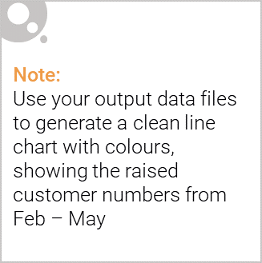
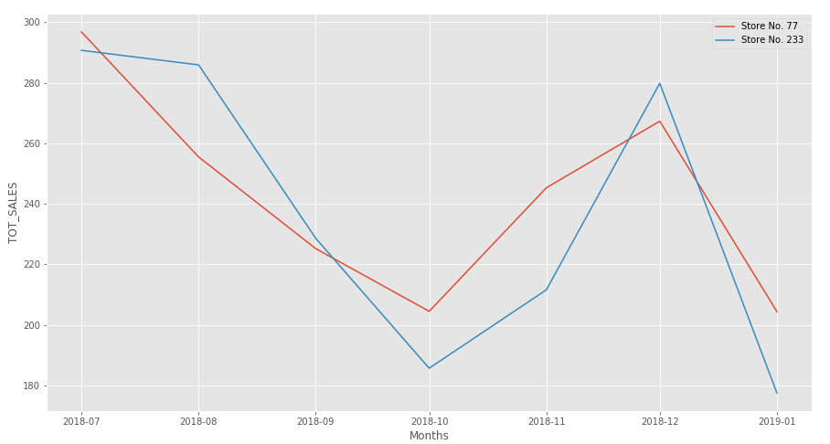
Trend lines of Total sales for Store 77 and Store 233.
You can see that the Trend lines of total sales for both Store 77 and Store 233 follows the similar path. Thus we select Store 233 as Control store for Store 77.

Slide 20
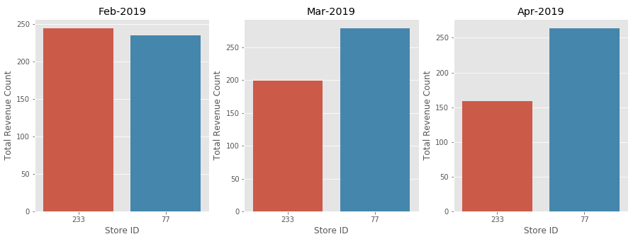
Compare monthly sales of store 233 and 77 during Trial period.
Above graph clearly shows that there is increase in sales of store 77 in month of March-2019 and April-2019.

Slide 21
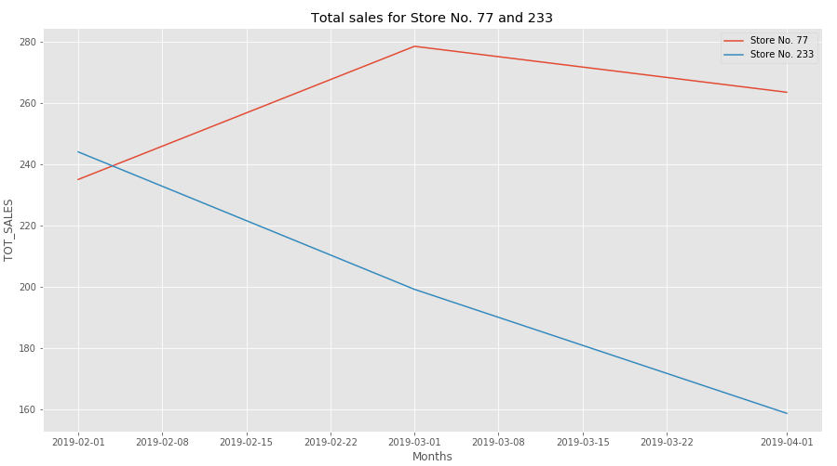
Trend lines of monthly sales for store 77 and 233 during Trial period.
You can see trend lines shows significant difference in sales in month of Mar-2019 and Apr-2019.

Slide 22
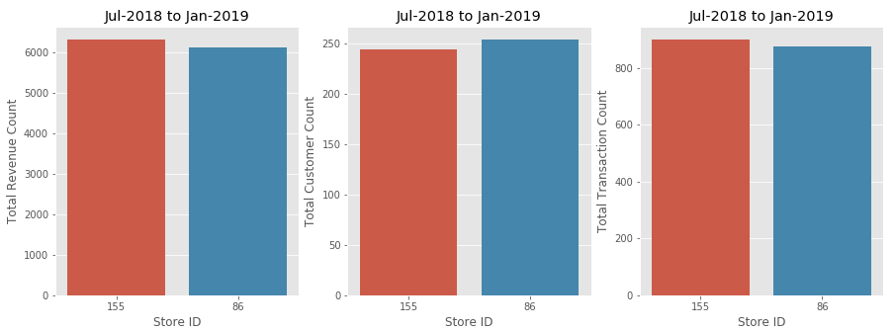
We've found control store 155 for trial store 86.
You can see from the bar graphs that Total Revenue count, Total Customer count and Total Transactions count of both store 86 and store 155 are quite similar before trial period ie. from date 01-07-2018 to 31-01-2019.

Slide 23
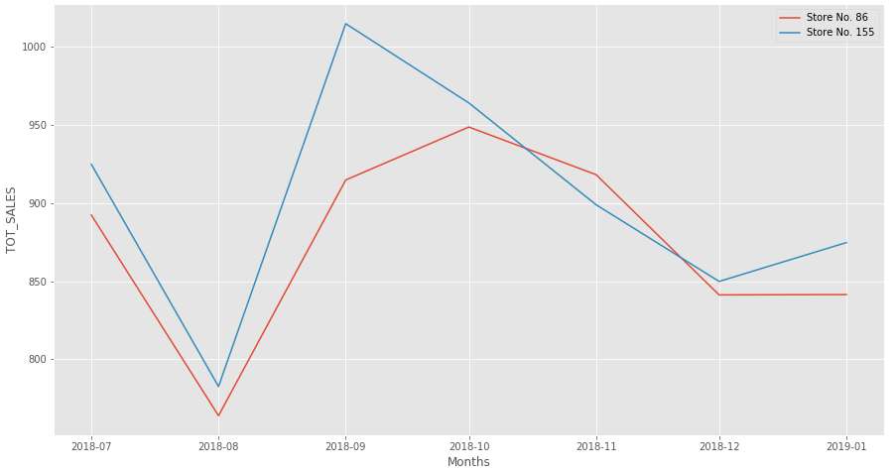
Trend lines of Total sales for Store 86 and Store 155.
You can see that the Trend lines of total sales for both Store 86 and Store 155 follows the similar path. Thus we select Store 155 as Control store for Store 86.

Slide 24
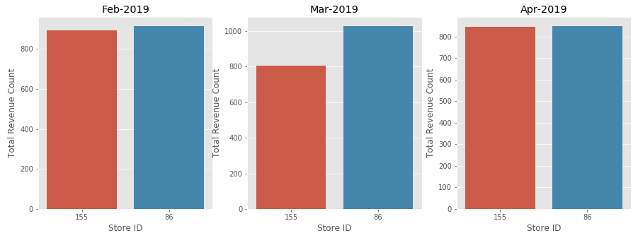
Compare monthly sales of store 86 and 155 during Trial period.
Above graph clearly shows that there is increase in sales of store 86 in month of March-2019 only, but then in Apr-2019 again the Sales shows similar results.

Slide 25
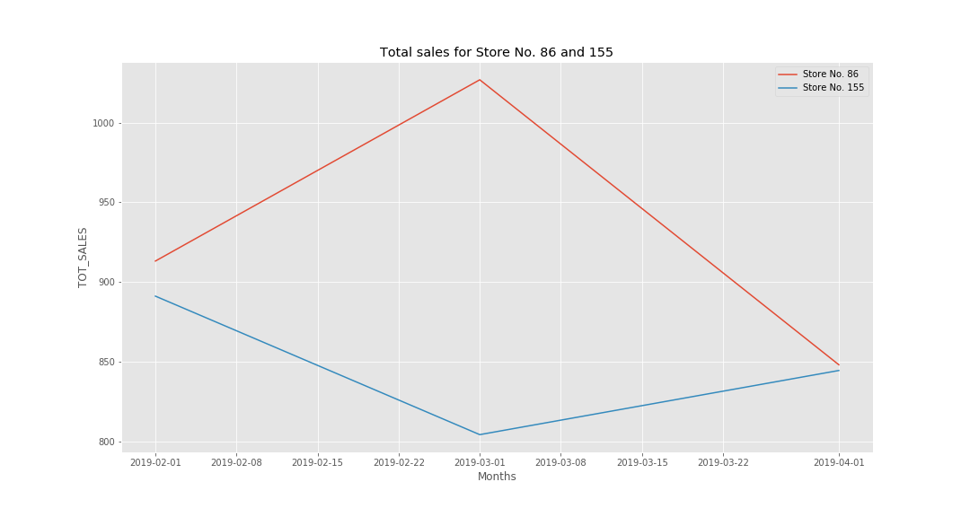
Trend lines of monthly sales for store 86 and 155 during Trial period.
You can see trend lines also shows significant difference in sales in month of March-2019 but not in month of Feburary-2019 and April-2019.

Slide 26
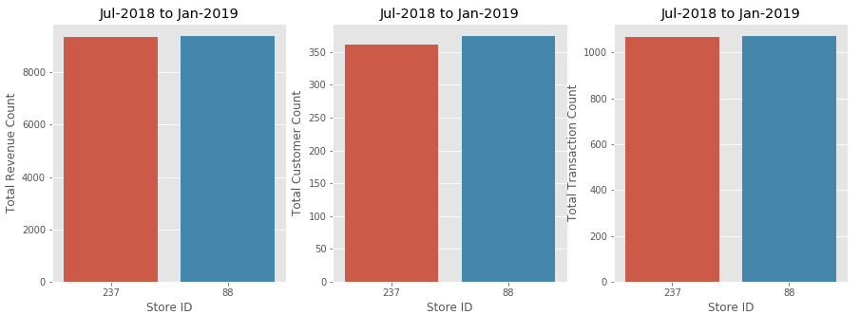
We've found control store 237 for trial store 88.
You can see from the bar graphs that Total Revenue count, Total Customer count and Total Transactions count of both store 88 and store 237 are quite similar before trial period ie. from date 01-07-2018 to 31-01-2019.

Slide 27
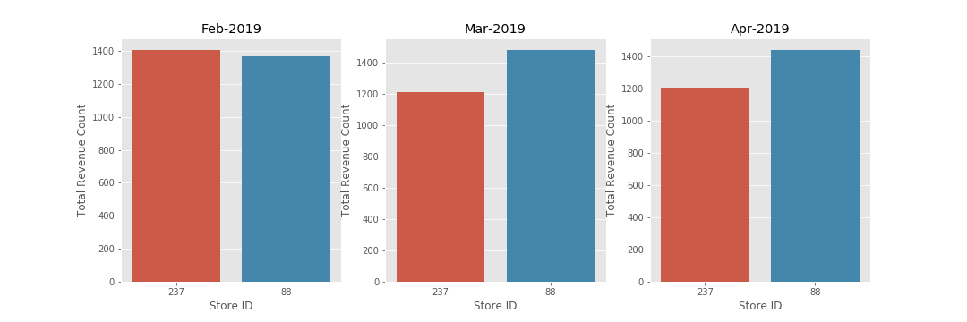
Compare monthly sales of store 237 and 88 during Trial period.
Above graph clearly shows that there is increase in sales of store 88 in month of March-2019 and April-2019.

Slide 28
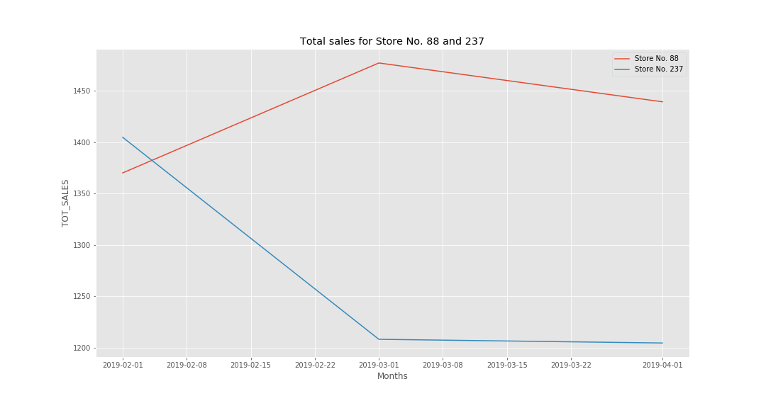
Trend lines of monthly sales for store 88 and 237 during Trial period.
You can see trend lines shows significant difference in sales in month of Mar-2019 and Apr-2019.

Slide 29
Insights:
1. Sales in Feburary-2019 for store number 77 is approx. same as its control store 233, but there is significant increase in sales in Store Number 77 in month March-2019 and April-2019 where as Store 233 shows us decrease in sales. Therefore we can say that changes made in Store 77 are effective.
2. Sales in Feburary-2019 for store number 86 is approx. same as its control store 155 and in next month (March-2019) sales for Store 86 increases abruptly than store 155, but in next month (April-2019) again the sales of both the stores becomes approximately equal. So we conclude that store number 86 is not showing us the significant changes and hence we say that changes made in Store 86 is not so effective like other trial stores.
3. Sales in Feburary-2019 for store number 88 is approx. same as its control store 237, but there is significant increase in sales in Store Number 88 in month March-2019 and April-2019 where as Store 237 shows us decrease in sales. Therefore we can say that changes made in Store 88 are effective.

Slide 30
Results: We've found control stores 233, 155, 237 for trial stores 77, 86 and 88 respectively.
The trial stores 77 and 88 during the trial period show a significant difference after one month from starting of trial period. But Store 86 does not show us significant change.
Recommendation: Give some details of changes make in trial stores so that we can figure out that why store 86 does not show significant difference.

